Slide 1
Come to my native town!
Author: Tikhonov Dmitry
Dolgoprudny, 2023

Slide 2
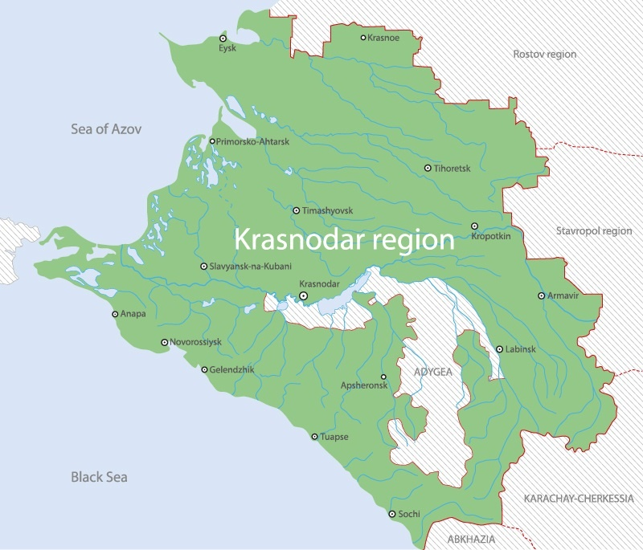
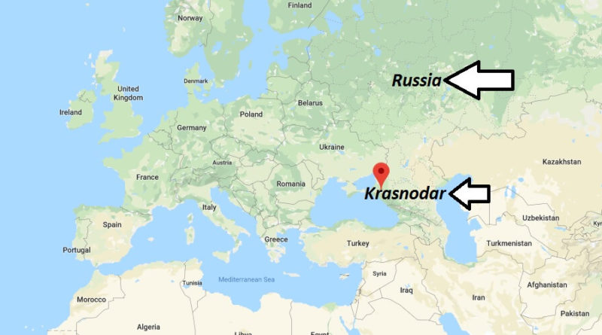
History of Krasnodar
Global map
Map of Krasnodar Region

Slide 3
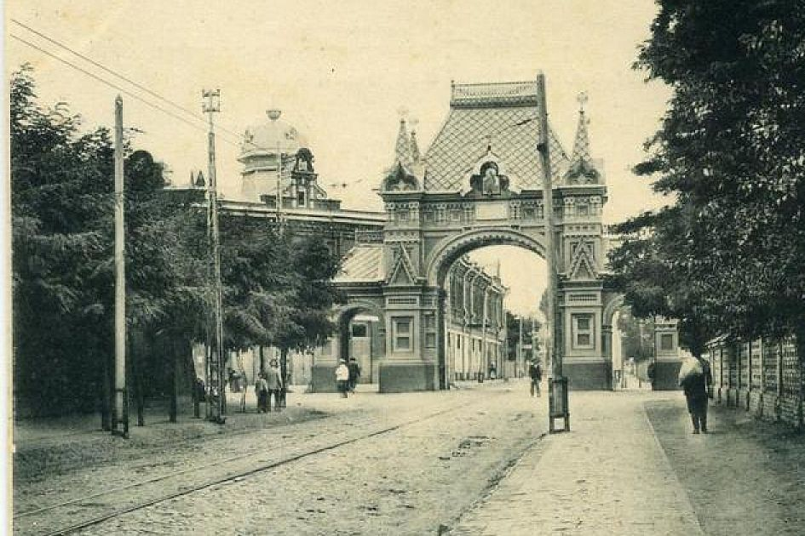
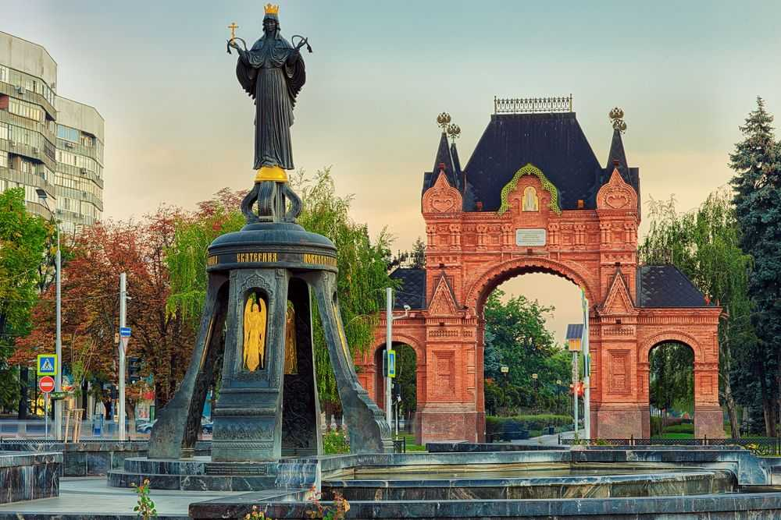
History of Krasnodar
1888 year
2023 year

Slide 4
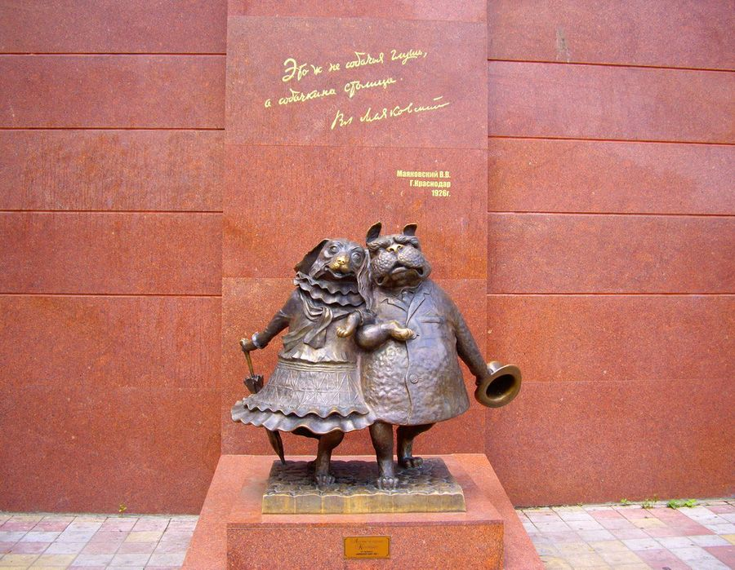
History of Krasnodar
https://krr.ru/pics/uploads/sights/3457300.jpg

Slide 5
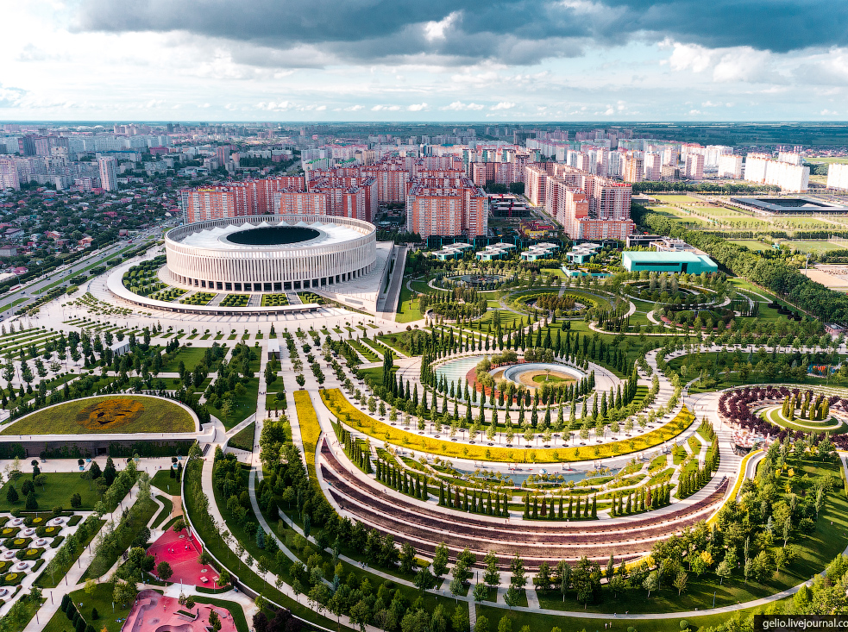
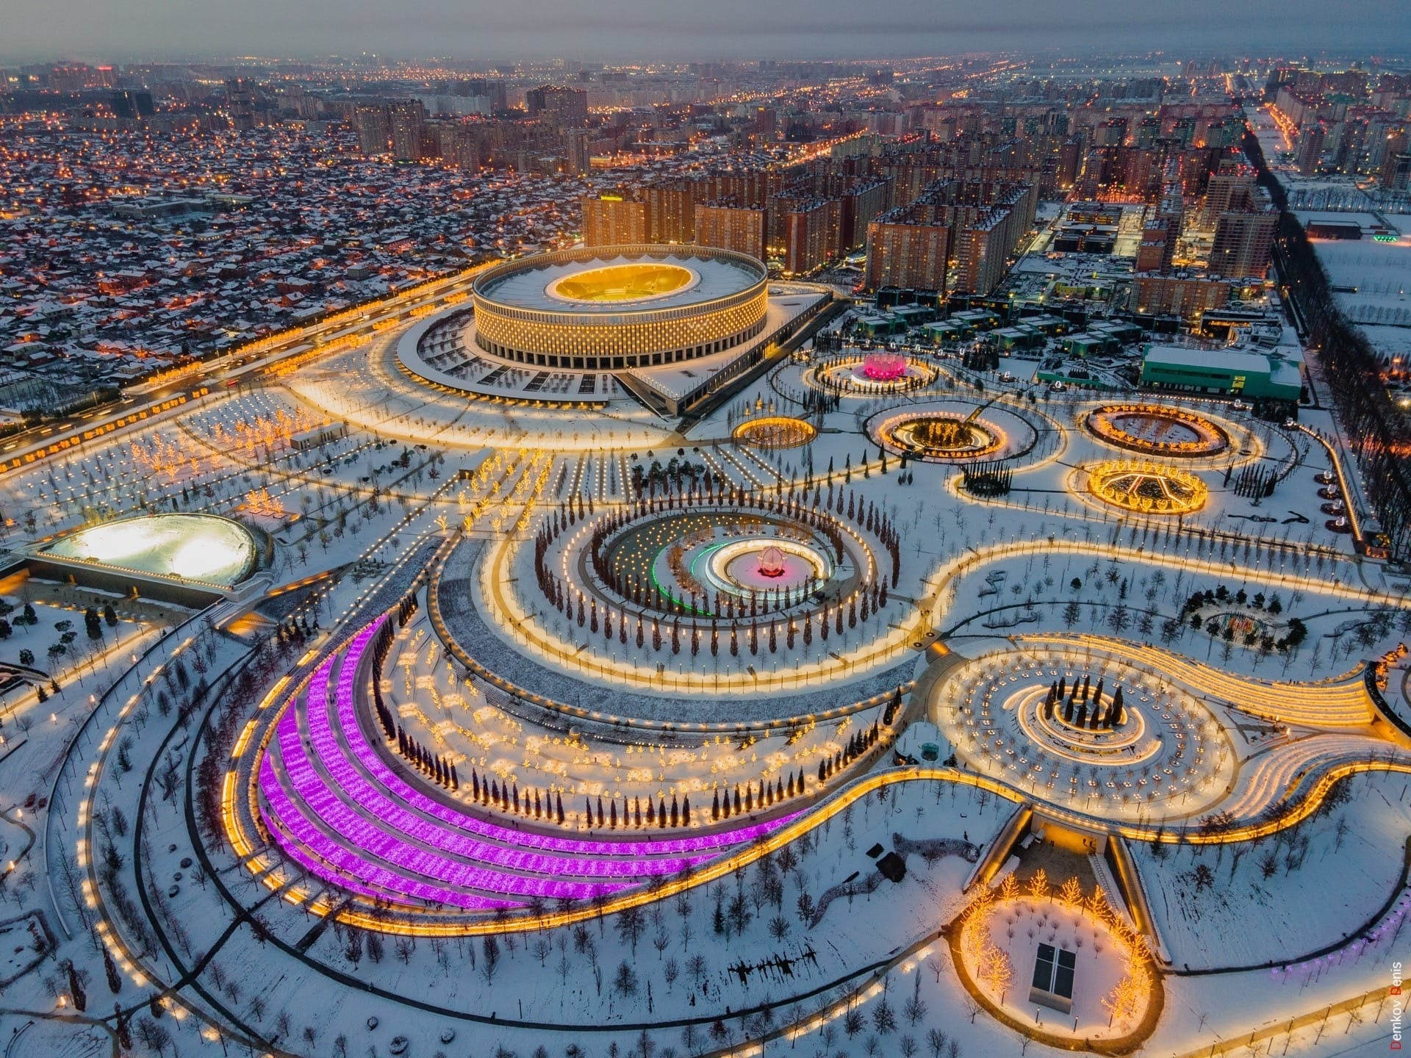
Krasnodar Park
https://krr.ru/pics/parks/posts/1.jpg
https://krr.ru/pics/parks/posts/2.jpg

Slide 6
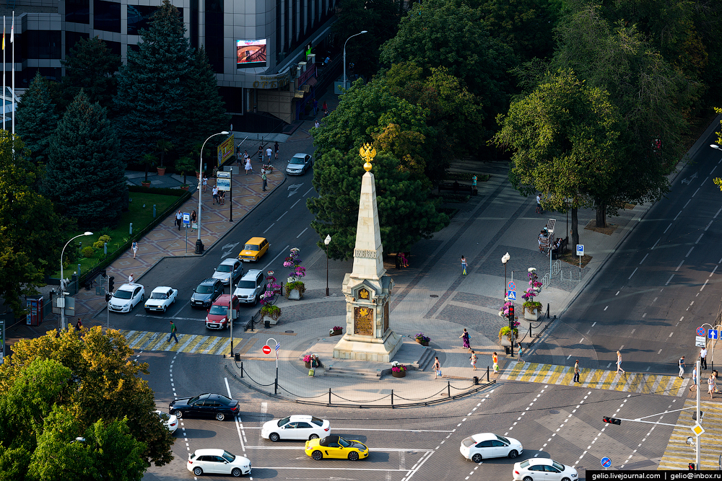
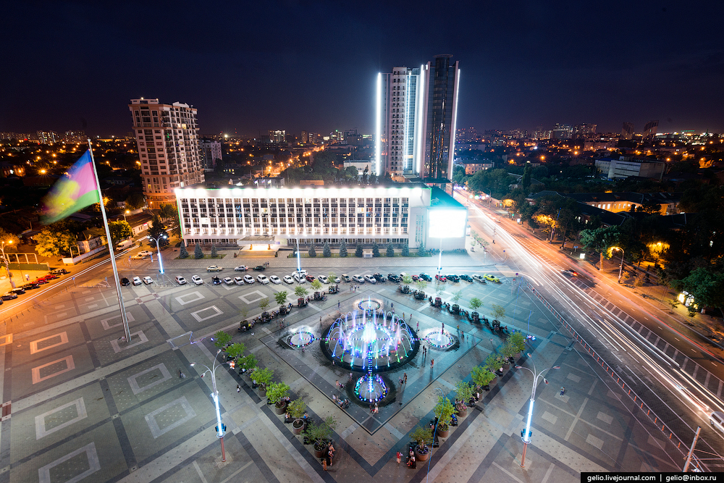
Krasnaya Street
https://krr.ru/pics/uploads/posts/2022-10/1660496300.jpg
https://krr.ru/pics/uploads/posts/2019-10/1660496300.jpg

Slide 7
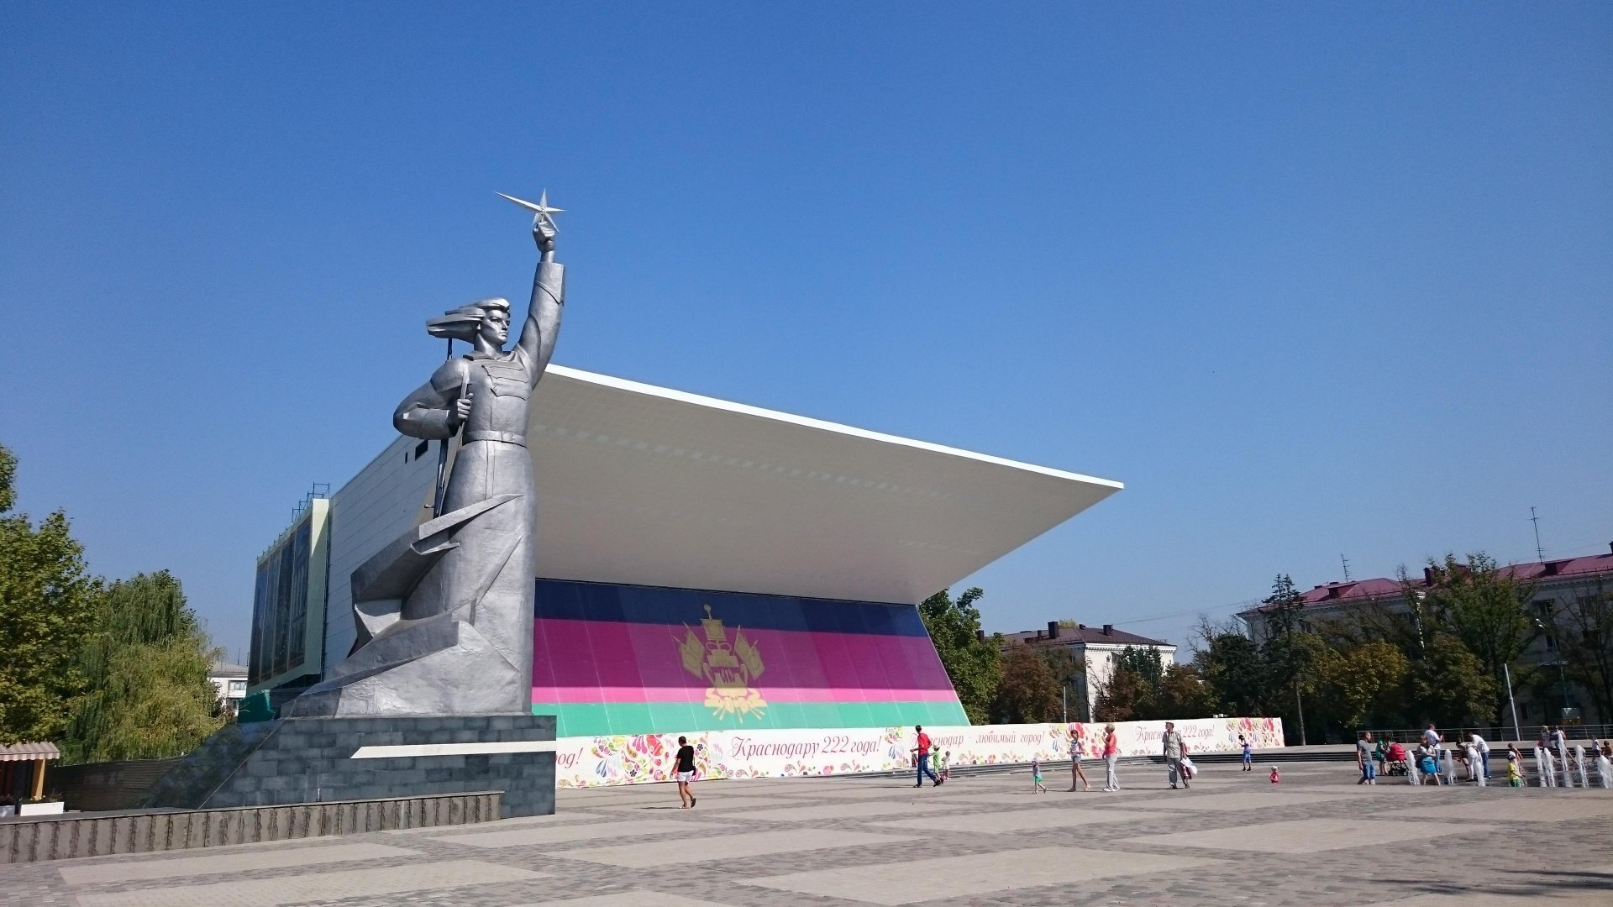
The Aurora cinema
https://krr.ru/pics/uploads/posts/2022-08/1660496300.jpg

Slide 8
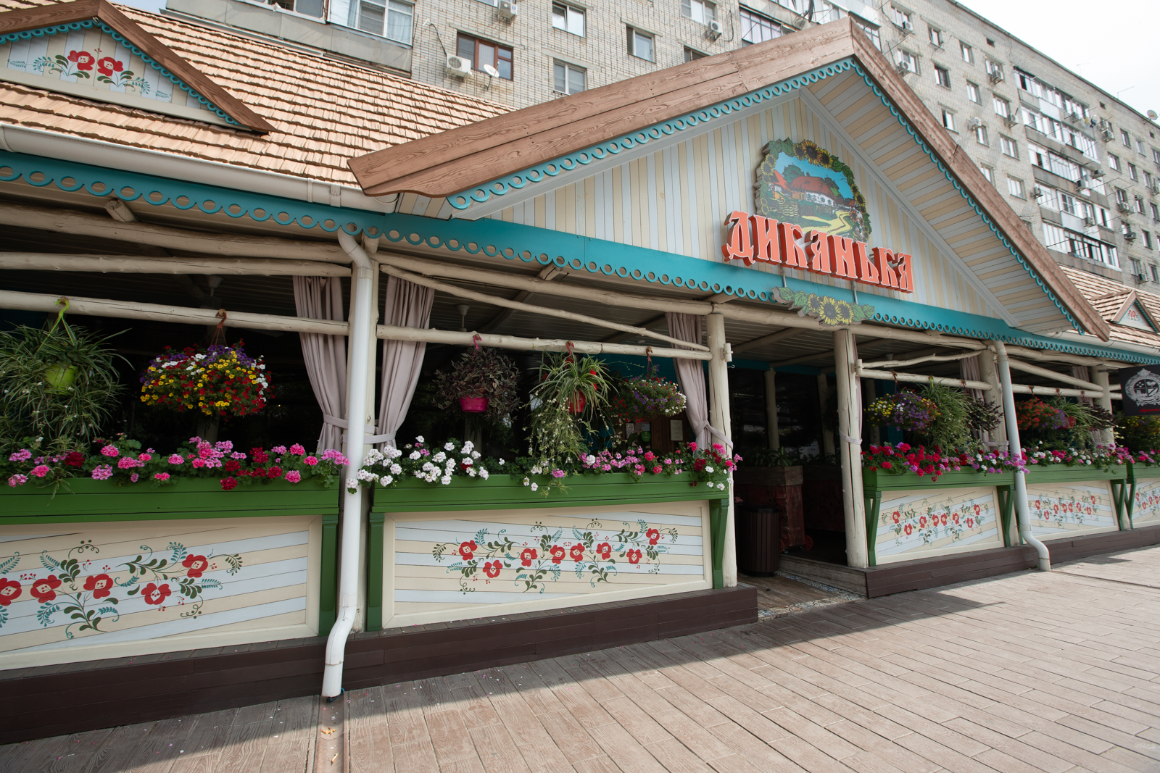
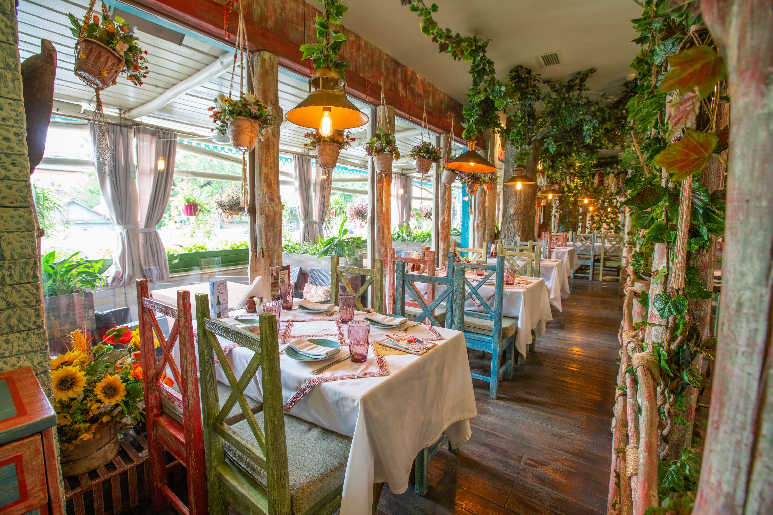
Places to eat
Restaurant Yuzhanin
Restaurant Dikanka

Slide 9
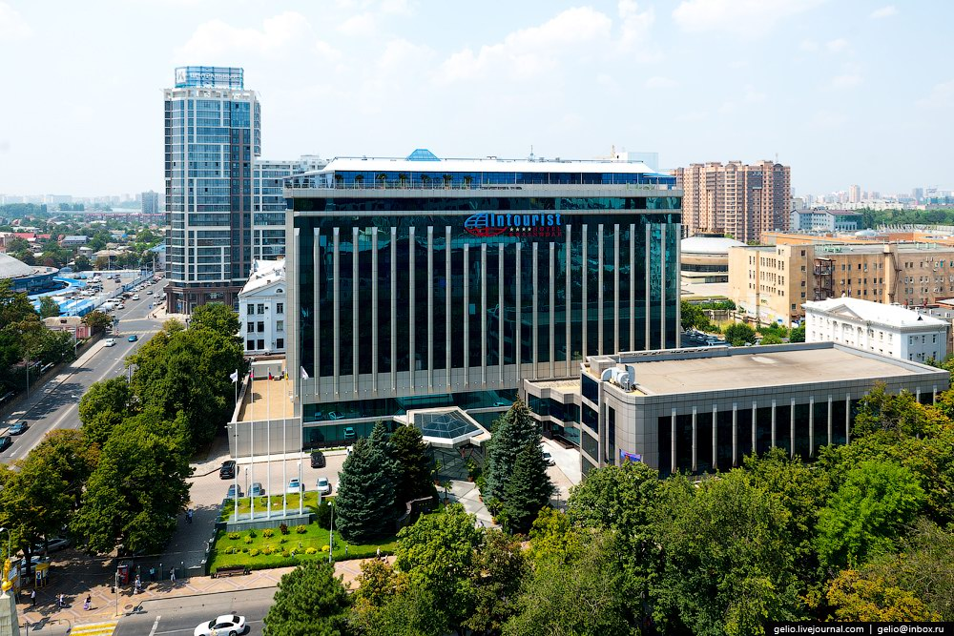
Place to stay
The Intourist Hotel

Slide 10
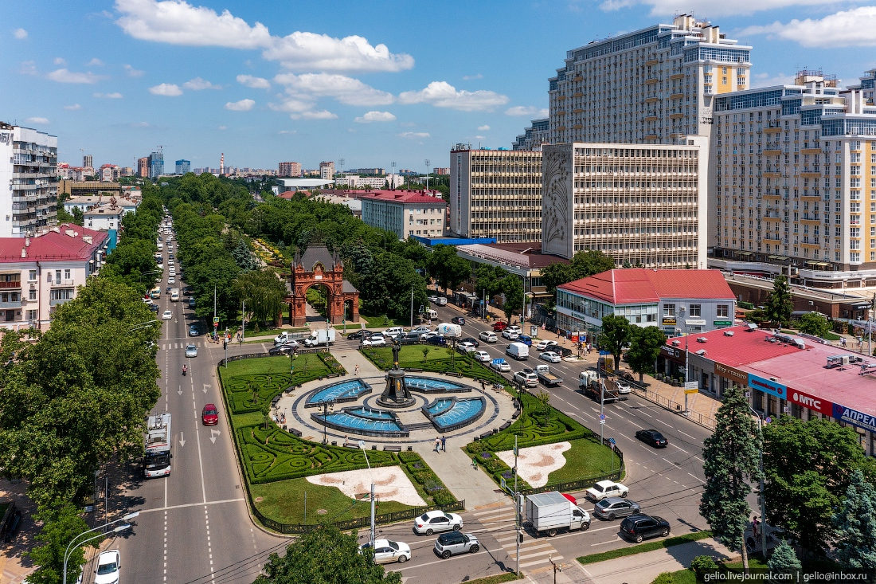
Conclusion
https://krr.ru/pics/uploads/posts/2022-08/1660496300.jpg

Slide 11
Thank you for your attention!

Slide 12
Links
https://krd.ru/
https://vk.com/krdru
https://kuban.29ru.net/krasnodar
https://93.ru/

